Slide 1
MAINSTREAM BENEFITS
TANF

Slide 2

TEMPORARY ASSISTANCE FOR NEEDY FAMILIES (TANF)
U.S. DEPARTMENT OF HEALTH & HUMAN SERVICES (HHS)

Slide 3
A Brief History of Welfare
Temporary Assistance for Needy Families (TANF /tænɪf/) is a federal cash assistance program of the United States. It began on July 1, 1997 and replaced the Aid to Families with Dependent Children (AFDC) program, providing cash assistance to indigent American families through the United States Department of Health and Human Services. TANF is often simply referred to as welfare.
In 1935, President Roosevelt signed the Social Security Act -- and created the Aid to Dependent Children Program (ADC) as part of The New Deal -- the precursor to today's federal welfare system. Originally, ADC went primarily to white widows and orphans -- who were considered "deserving poor."

Slide 4
A Brief History of Welfare
In 1962, benefits were extended to “families”, defined as a 2-parent family in which the male was unemployed but not absent or disabled. Because it was seen as disincentive to marriage (widows and orphans). The name was changed to Aid to Families with Dependent Children (AFDC). Also, extended benefits to women of color.
In 1967, child support / paternity establishment began.
In 1996, the Personal Responsibility and Work Opportunity Reconciliation Act (PRWORA) established lifetime Time Limits and changed the name to Temporary Assistance for Needy Families (TANF).
Federal Rules took effect on July 1, 1997
TANF was reauthorized in February 2006 in the Budget Reconciliation Act of 2005.

Slide 5
A Brief History of Welfare
Debates leading up to welfare reform and PRWORA centered on five themes:
Reforming Welfare to Promote Work and Time Limits
Reducing Projected Spending
Promoting Parental Responsibility
Addressing Out-of-Wedlock Birth
Promoting Devolution (State & Local rather than Federal Control)

Slide 6
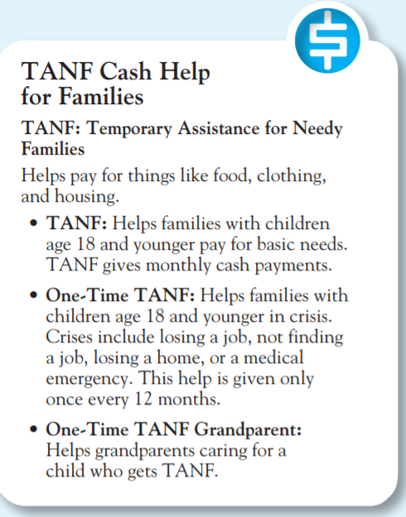
TANF
https://hhs.texas.gov/services/financial/cash/tanf-cash-help
Monthly cash payments
Families with children age 18 and younger
Families who can get this help have little to no money or don’t have a way to get money
A family can be: (1) parent(s) and their children, or (2) relative(s) caring for related children

Slide 7
WHAT IS TANF?
TANF & Choices services are funded through a combination of state and federal funds (MOE). The federal TANF block grant was created with the passage of the 1996 Personal Responsibility and Work Opportunity Reconciliation Act (PRWORA) that eliminated Aid to Families with Dependent Children (AFDC), the long-standing federal cash assistance program. TANF was reauthorized in February 2006 as part of the 2005 Budget Reconciliation Act.

Slide 8
TANF Program
Topics
The Employment Program associated with TANF Receipt in Texas is called “Choices”
Work Registration Codes:
Time Limits:
Federal Time Limit
State Time Limits
2-Parent Time Limits
HHSC Cut-off
Mandatory vs. Exempt

Slide 9
WORK REGISTRATION
Code | Description
V | non-recipient parents who receive Supplemental Security Income (SSI)
X | non-recipient parents who have exhausted their state time limits
Y | non-recipient parents who have certain disqualifications
J | ineligible for TANF and for Choices
A or F | child under age 19 or adult age 60 or older
L, N or Q | receiving hardship exemption from the state time limit
G or R | caring for a child under age 1 / person not on TANF
C | caring for a disabled child
U | grandparent (age 50+) caring for a child under age 3
H | caring for a disabled adult
E | personal disability
T | pregnant and unable to work
K* | appeal pending with Choices
W* | sanctioned for Choices nonparticipation
P | employed at least 30 hours per week and earning at least $700 per month
B | parent under age 19 and in school full time
M | mandatory participant
Codes assigned by HHSC to individuals who apply for TANF cash assistance, which determines if recipients are mandatory or exempt participants in the Workforce Choices program.
TIERS determines the appropriate work registration code based on data collection entries. Staff should review work registration status prior to disposition to ensure the correct work registration code is assigned to an individual.

Slide 10
Texas TANF & Choices Programs https://www.twc.texas.gov/programs/choices-program-overview
Choices provides services to two populations:
  Single-parent families
  Two-parent families
Choices is Texas’ TANF Employment and Training Program that operates under a work first service model.
Choices individuals receive a consistent message:
  Government assistance is temporary
  Texans are responsible for the support of themselves and their families
  Employment is the goal
WOA, EPS, Mandatory / Exempt, Work Requirement, Support Services
MORE ON THIS IN THE CHOICES TRAINING…..

Slide 11
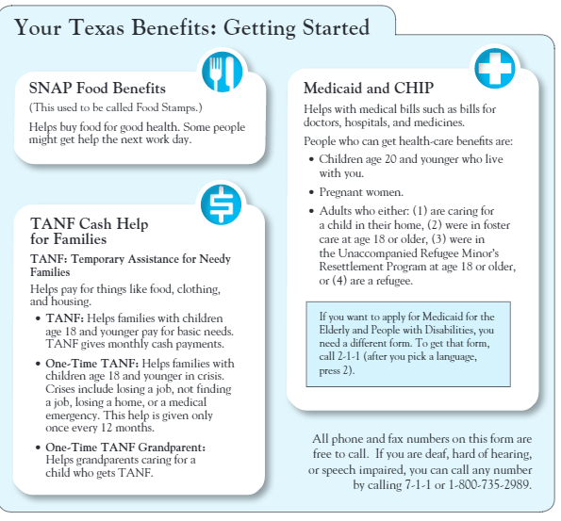
The Application
What questions do you have about the form?
What was the easiest part?
What was the hardest part?
Could you tell from the application what documentation you would have to provide?
What about Medicaid?
https://yourtexasbenefits.com/GeneratePDF/StaticPdfs/en_US/H1010_Jan2022.pdf

Slide 12
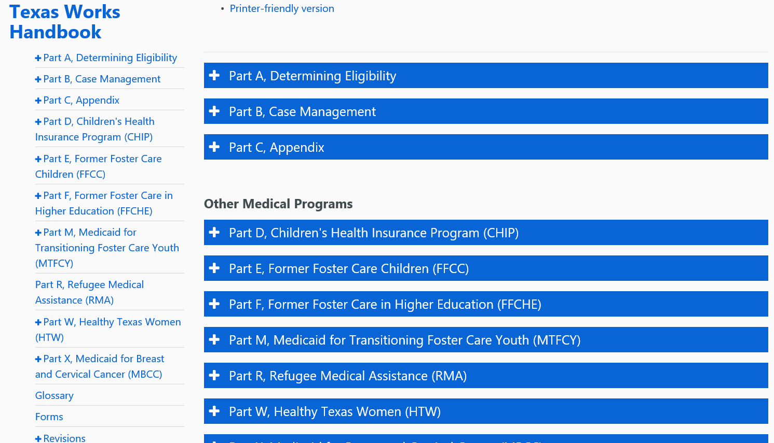
https://hhs.texas.gov/laws-regulations/handbooks/twh/texas-works-handbook
HHSC Handbooks Online

Slide 13
TANF Eligibility Points & Definitions
A-200, Household Composition – Who all lives in the household
A-300, Citizenship - U.S. citizens and certain legally-admitted alien residents are eligible for benefits if they meet all other eligibility criteria.
A-400, Social Security Number - All applicants must provide a Social Security number (SSN) or apply for one through the Social Security Administration (SSA) before certification (Exceptions: Undocumented aliens, Children age six months or younger, not eligible to receive an SSN, do not have an SSN and may only be issued an SSN for a valid non-work reason, or well-established religious objection)
A-500, Age/Relationship – Age of each person applying for benefits / connection to applicant by blood or marriage
A-600, Identity - Advisors must verify the identity of the person interviewed, only once
A-700, Residence - Applicants must live in Texas to be eligible for benefits. The household is not required to have a permanent dwelling or fixed residence.
A-800, Medicaid Eligibility - Applicants may receive Medicaid during the three-month period before the month they apply for Medicaid.

Slide 14
TANF Eligibility Points & Definitions
A-900, Domicile - A residence maintained or being established, as evidenced by continuation of responsibility for day-to-day care of the child, by the relative with whom the child is living.
A-1000, Deprivation - Loss of parental support caused by death, incapacity, continued absence of one or both natural or adoptive parents, or because of unemployment or underemployment of both parents in a two-parent family.
A-1100, Child Support - A payment made from a biological or adoptive parent to a biological or adoptive child. Child support may be:
  Formal – court-ordered or legally mandated; or
  Voluntary – not court-ordered and given voluntarily when the child’s caretaker or the person making the payment states the purpose of the payment is to support the child.
A-1200, Resources - Both liquid and nonliquid assets an individual can convert to meet immediate needs.
A-1300, Income - Income is any type of payment that is of gain or benefit to a household and is either counted or exempted from the budgeting process. Earned income is related to employment. Unearned income is income received without performing work-related activities and includes benefits from other programs.

Slide 15

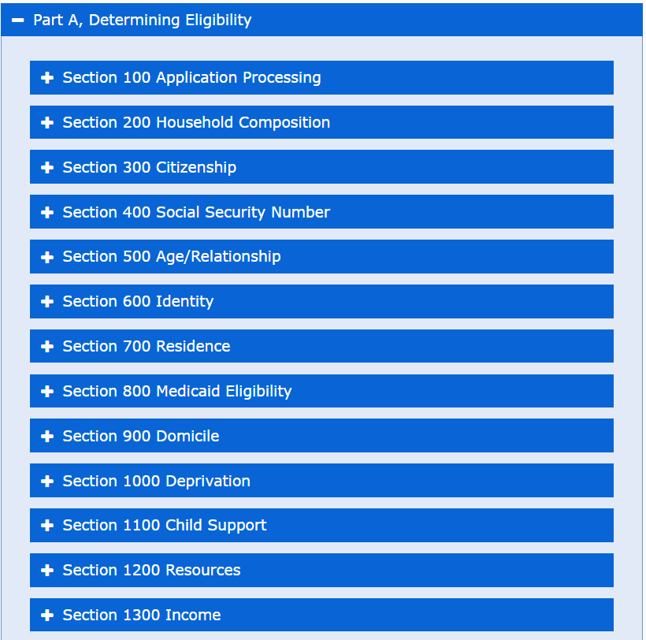
https://hhs.texas.gov/laws-regulations/handbooks/twh/texas-works-handbook
TANF ELIGIBILITY

Slide 16
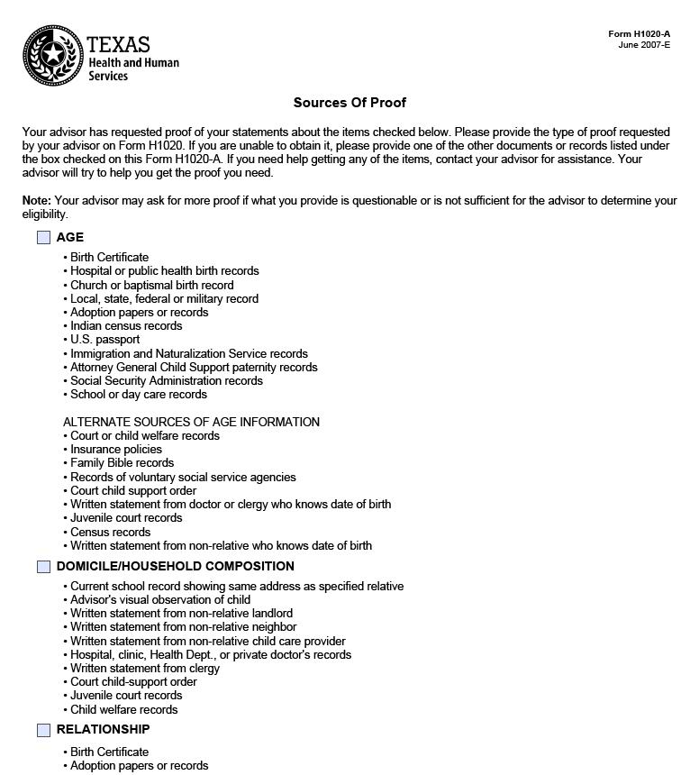
Form 1020-A
https://www.hhs.texas.gov/sites/default/files/documents/laws-regulations/forms/H1020-A/H1020-a.pdf

Slide 17

US DEPARTMENT OF HEALTH & HUMAN SERVICES (HHS)
TANF
YOU, THE TAXPAYER
$$
$$
$ STATE LEVEL M.O.E. $
$ + $
TWO PARENT TANF $$
SINGLE PARENT TANF $$
TEXAS HEALTH & HUMAN SERVICES COMMISSION (HHSC)
$$

Slide 18

Single-Parent TANF
Cash assistance & Medicaid for all family members in the certified group for a single-parent family or a two-parent family in which one parent is disabled and unable to work.
Individuals with disabilities and individuals caring for a family member with a disability as supported by medical documentation must have their Choices participation requirements determined by a physician.

Slide 19

Two-Parent TANF (State Program)
Cash assistance & Medicaid for a family in which both parents are present, both are unemployed, and neither receives SSI.
One or both adults in a two-parent household are responsible for meeting the family’s mandatory work requirement.

Slide 20

One-Time TANF
A lump sum, ONE-TIME grant of $1,000 offered through HHSC and intended to help TANF applicants experiencing short-term crises by providing upfront financial assistance along with exposure to the services offered by Workforce Solutions Offices.
TANF applicants who receive OTTANF are not eligible to participate in Choices or receive TANF assistance for the 12 months following receipt of OTTANF.

Slide 21

FEDERAL TIME CLOCK
FEDERAL: 1996
60 Months LIFETIME
Maintenance Of Effort (MOE) Money: ½ State, ½ Federal (1:1 Match)
  TANF 1-Parent Grant: Federal Funds + MOE
  TANF-SP (State Program): (2-Parent TANF Grant): State MOE Only
The TANF State Program (TANF-SP), created specifically for two-parent households, is a state-funded program and is not subject to federal time limits.
Each TANF-SP adult has a 60-month state program life-time limit. The time-limit clock starts ticking with the initial receipt of benefits.
For two-parent families, any month of TANF benefits subject to state time limits since October 1, 2001, counts toward the family’s lifetime cap, regardless of which parent received the benefits.

Slide 22



Meanwhile, Back on the Texas Ranch…1995
In 1995, the Texas Legislature was in its Biennial Meeting as the country buzzed with “Welfare Reform”.
Texas wanted to pass their own rules BEFORE the Federal Government imposed their rules.
Texas decided on Time Limits based on the individual’s level of education and work experience.
Texas Rules passes under HB 1863 which also consolidated workforce programs, eliminated TEC, created TWC, & created the Workforce Boards.
Texas Rules went into effect on September 1, 1995.

Slide 23

Texas State Time Limits
A-402: Time Limit Tiers: 12-, 24-, and 36-Month State Time Limits: The state has a time limit of 12, 24 or 36 months on ONE-parent TANF, based on an individual’s education, functional literacy level and work experience. HHSC determines an individual’s state time limit. State time limits apply only to adult TANF recipients who are mandatory or who are exempt and voluntarily participate in Choices. When a TANF recipient’s state time limits expire, the state imposes a five-year freeze-out for the adult; benefits for the children, however, continue.
There are three-time limits, known as tiers. Tiers, with their corresponding state time limits, are defined as follows:
• Tier 5 (12 months) – Individual has an education level that is at least equivalent to a high school diploma and/or has at least 18 months of recent work history.
• Tier 6 (24 months) – Individual completed three years of high school and/or has six to 17 months of recent work history.
• Tier 7 (36 months) – Individual completed fewer than three years of high school and/or has fewer than six months of recent work history.

Slide 24
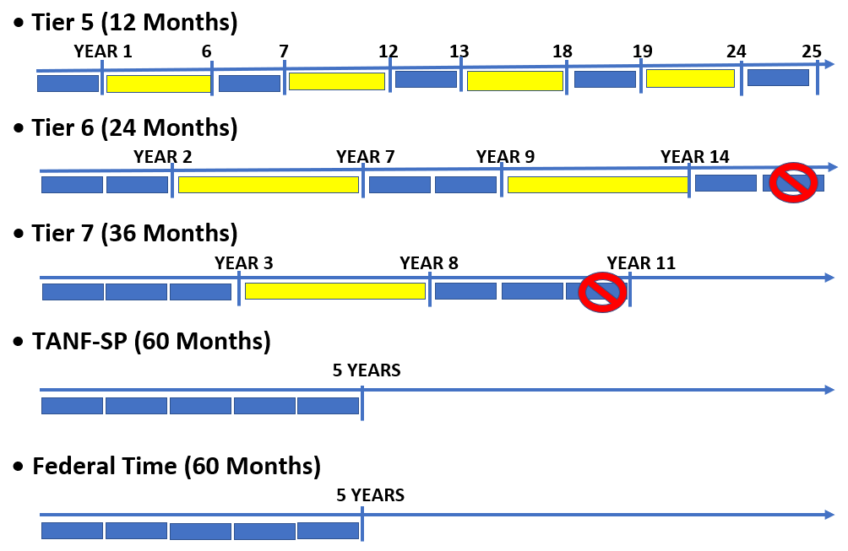
12 Months =
5-Year Freeze-Out =

Slide 25

WHAT IS A FREEZE-OUT?
CARETAKER
CHILD 1
CHILD 2

Slide 26
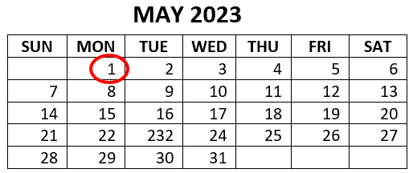
HHSC Cut-Off Explained...
Any action taken by HHSC takes effect on the first of a month. Benefit changes NEVER take effect on any other day of the month.
Which month the change takes effect is based on a “Cut-off” date.
Any action that is taken from the day after one cut-off date, up to and including the cut-off date of the next month, will take effect on the first day of the following month.
Receipt of a benefit does not mean that the client is entitled to that benefit.

Slide 27
MONTH | CUT-OFF DATE | CUT-OFF TO CUT-OFF | FORM EFFECTIVE DATE
January 2023 | Wednesday, 01/18/23 | 12/15 – 1/18 | 02/01/23
February 2023 | Wednesday, 02/15/23 | 1/19 – 2/15 | 03/01/23
March 2023 | Thursday, 03/16/23 | 2/16 – 3/16 | 04/01/23
April 2023 | Thursday, 04/13/23 | 3/17 – 4/13 | 05/01/23
May 2023 | Thursday, 05/18/23 | 4/14 – 5/18 | 06/01/23
June 2023 | Thursday, 06/15/23 | 5/19 – 6/15 | 07/01/23
July 2023 | Tuesday, 07/18/23 | 6/16 – 7/18 | 08/01/23
August 2023 | Thursday, 08/17/23 | 7/19 – 8/17 | 09/01/23
September 2023 | Thursday, 09/14/23 | 8/18 – 9/14 | 10/01/23
October 2023 | Wednesday, 10/18/23 | 9/15 – 10/18 | 11/01/23
November 2023 | Thursday, 11/16/23 | 10/19 – 11/16 | 12/01/23
December 2023 | Thursday, 12/14/23 | 11/17 – 12/14 | 01/01/24

Slide 28
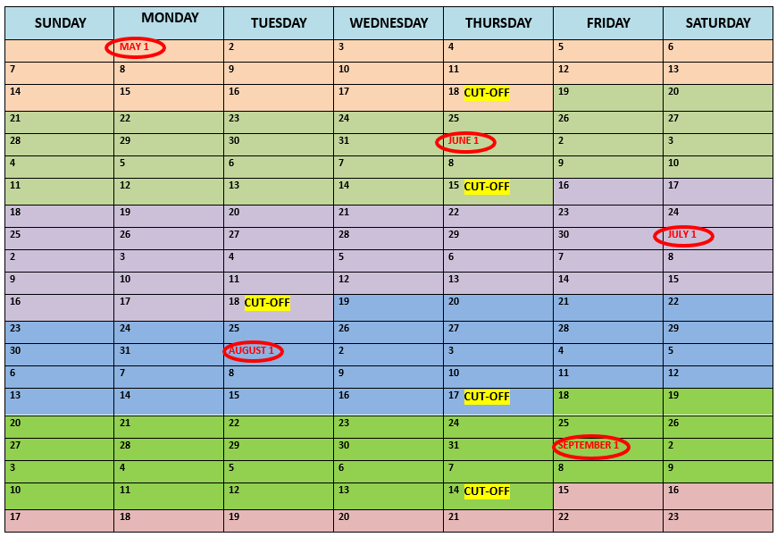
HHSC CUT-OFF 2023

Slide 29

Thank You! Questions?

